Slide 1

Detecting Brain tumors in Magnetic Resonance Imaging (MRI)
GWU
Machine Learning Group 5
Maliha Aziz, Zongzhu Li

Slide 2

Outline
Introduction
Overview of Dataset for Different Types of Brain Tumors
Data Preprocessing
Modeling, Prediction and Evaluation
SVM, KNN and Naïve Bayes
ANN with Parameters Exploratory
Summary and Discussion

Slide 3
Introduction
Challenge in Brain Cancer Diagnosis
Breaking through the blood-brain barrier
The challenges of surgical removal
The efficiency and accuracy of brain cancer diagnosis by doctors
Application of Machine Learning in Brain Cancer Diagnosis
Assist a neuro-oncologist in diagnosing brain tumors
Increase the efficiency and accuracy of brain cancer diagnosis

Slide 4
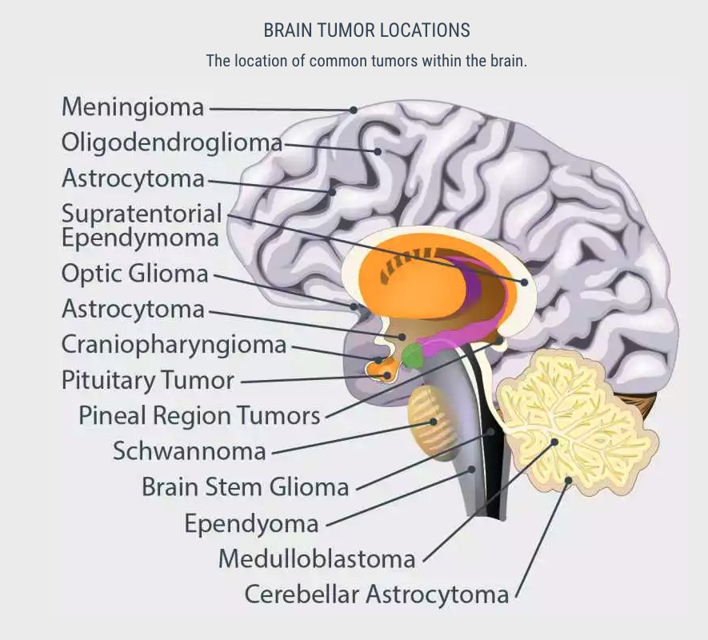
Brain Cancer Types
Notes:
https://miamineurosciencecenter.com/en/conditions/brain-tumors/types/

Slide 5
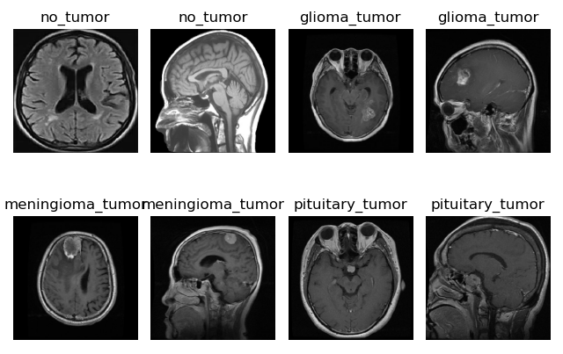
Overview of Dataset for 3 Types of Brain Tumors
{'glioma_tumor': 826, 'meningioma_tumor': 822, 'no_tumor': 395, 'pituitary_tumor': 827}
512 X 512 JPG file
https://www.kaggle.com/sartajbhuvaji/brain-tumor-classification-mri

Slide 6
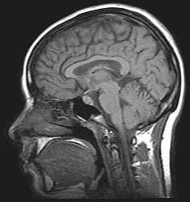
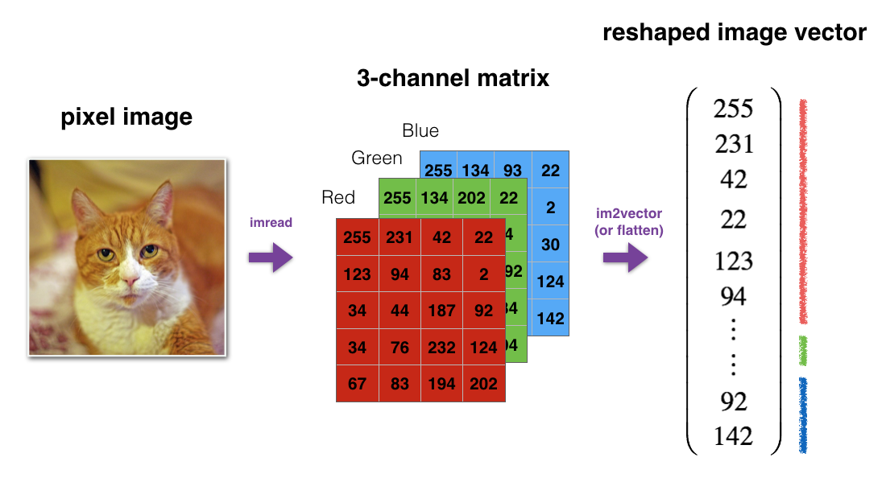
Data Preprocessing
Resize --- (128 X 128)
Transform to array from image
Normalization---(/255.0)
Data Augmentation---(ImageDataGenerator)
rotation_range=20,
width_shift_range=0.2,
height_shift_range=0.2,
zoom_range=0.2,
horizontal_flip=True
Data reshape from 3D to 2D
Notes:
# Image Data Augmentation: Image data augmentation is a technique that can
be used to artificially expand the size of a training dataset by creating modified versions of images in the dataset.
It uses techniques such as flipping, zooming, padding, cropping, etc. # Data augmentation makes the model more robust to slight variations, and hence prevents the model from overfitting.

Slide 7
Modeling, Prediction and Evaluation

Slide 8
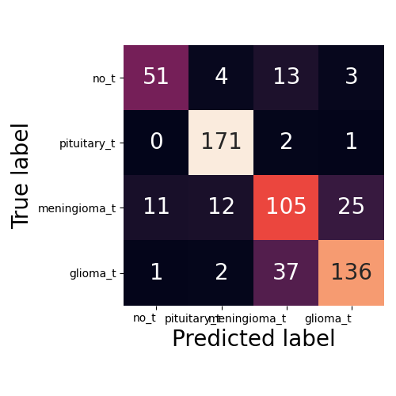
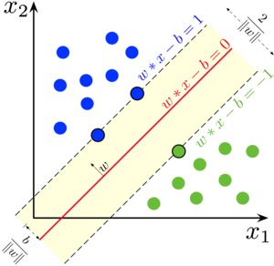
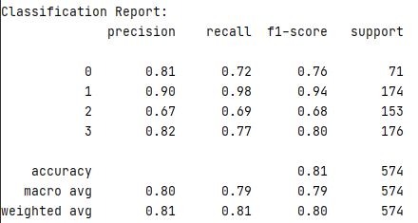
Modeling, Prediction and Evaluation -- SVM
clf = SVC(kernel="poly")

Slide 9
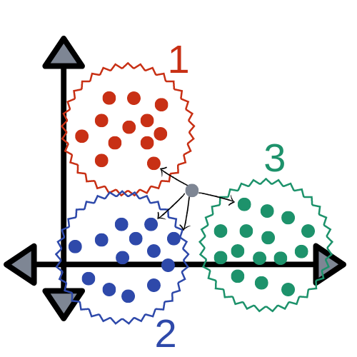
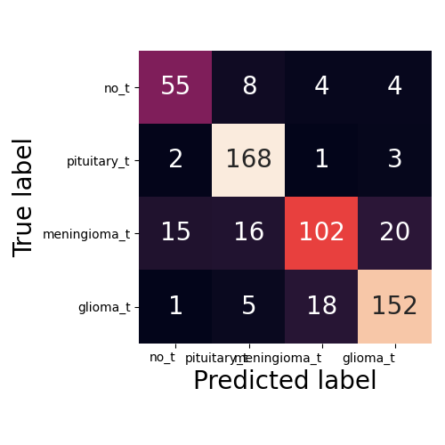
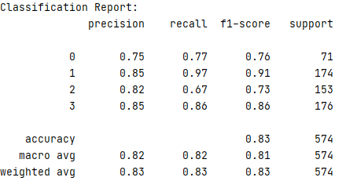
Modeling, Prediction and Evaluation -- KNN
clf = KNeighborsClassifier(n_neighbors=4)

Slide 10
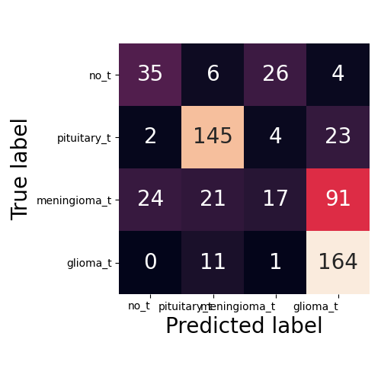
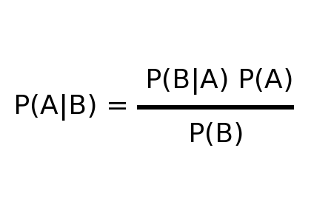
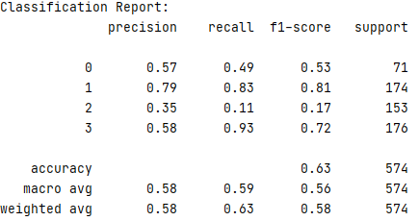
Modeling, Prediction and Evaluation -- Naïve Bayes
clf = GaussianNB()

Slide 11

Modeling, Prediction and Evaluation -- ANN
ANN optimum model discovery
Hidden layers and nodes
(20,20)/ (500,500) /(20,20,20,20)
Iteration numbers
500/ 2000
Activation
“sigmoid”/ “relu”
Early-stopping
Solver
Adam/SGD/RMSprop/Adagra/Adadelta/Adamax
Notes:
Dropout is a regularization technique for reducing overfitting in neural networks by preventing complex co-adaptations on training data. It is a very efficient way of performing model averaging with neural networks.

Slide 12

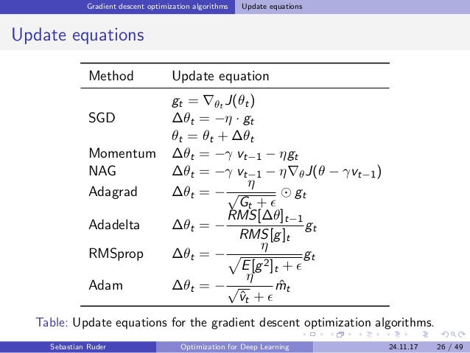
Optimizers
Source: Alec Radford
Source: Sebastian Ruder
Notes:
Adagrad (short for adaptive gradient) adaptively sets the learning rate according to a parameter.
AdaDelta belongs to the family of stochastic gradient descent algorithms, that provide adaptive techniques for hyperparameter tuning.
Adaptive Moment Estimation (Adam) combines ideas from both RMSProp and Momentum.
Root Mean Square Prop (RMSProp) works by keeping an exponentially weighted average of the squares of past gradients. RMSProp then divides the learning rate by this average to speed up convergence.
SGD's simplicity makes it a good choice for shallow networks. However, it also means that SGD converges significantly more slowly than other.
Adam, like RMSprop et. al., uses an exponentially decaying weighted average estimate of the variance of the gradient in its formulation. However, strictly speaking,
https://mlfromscratch.com/optimizers-explained/#/

Slide 13
Experiments Design and Results for ANN with Different Parameters
ANN | Layers & Nodes | Iteration | Activation | Early-stopping | Solver | Accuracy (%)
01 | (20, 20) | 500 | “sigmoid” | False | Adam | 84.5
02 | (20, 20) | 500 | “relu” | False | Adam | 79.4
03 | (20, 20) | 500 | “sigmoid”, ”relu” | False | Adam | 82.1
04 | (500, 500) | 500 | “sigmoid” | True | Adam | 85.2
05 | (20, 20, 20,20) | 500 | “sigmoid” | False | Adam | 80.8
06 | (20, 20) | 2000 | “sigmoid” | False | Adam | 82.2
07 | (20,20) | 500 | “sigmoid” | False | SGD | 81.2
08 | (20, 20) | 500 | “sigmoid” | False | RMSprop | 84.8
09 | (20, 20) | 500 | “sigmoid” | False | Adagrad | 81.0
10 | (20, 20) | 500 | “sigmoid” | False | Adadelta | 78.6
11 | (20,20) | 500 | “sigmoid” | False | Adamax | 73.3
ANN | (500, 500, 20) | 500 | “sigmoid” | False | RMSprop | 87.5

Slide 14
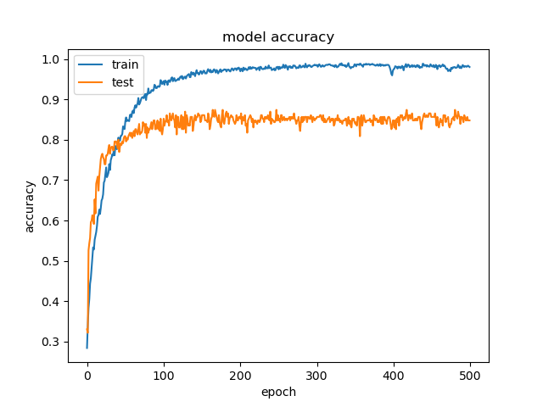
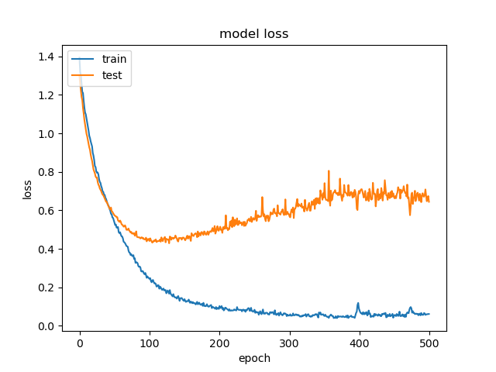
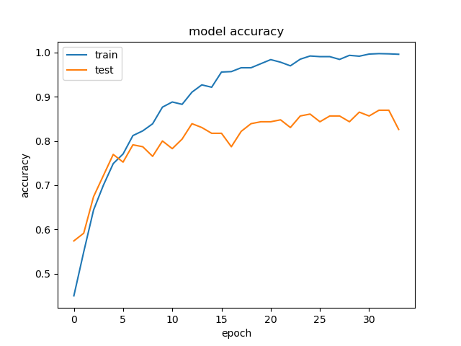
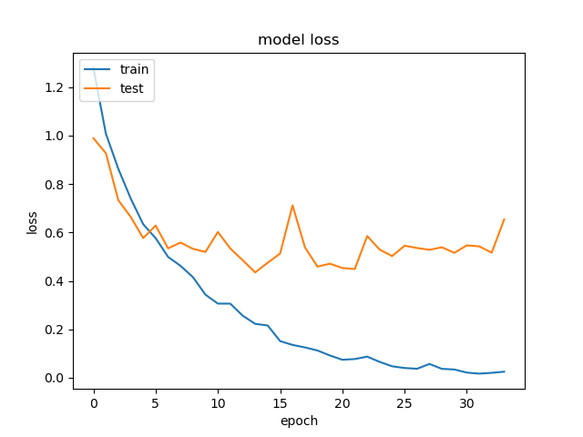
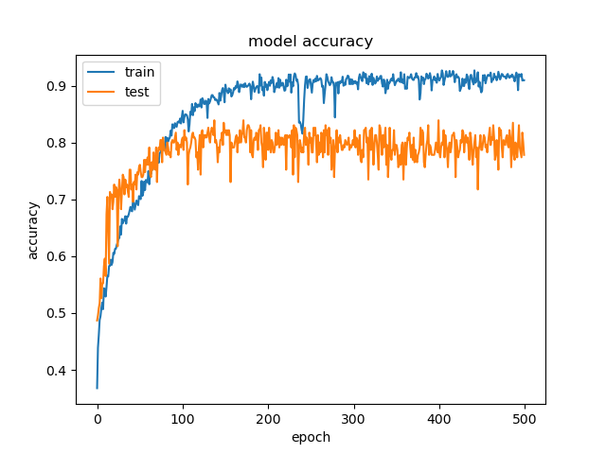
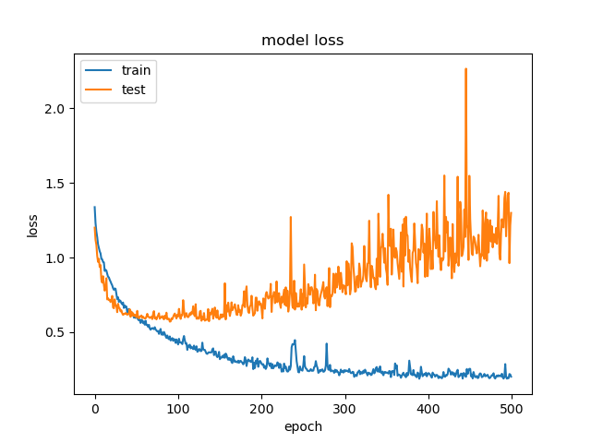
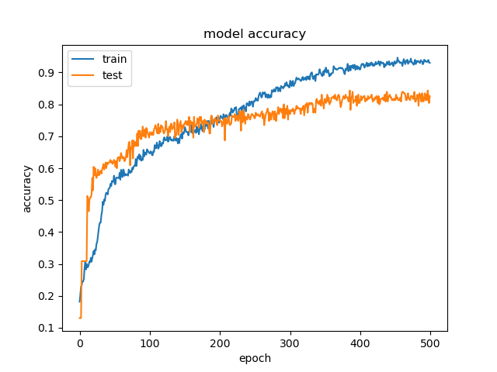
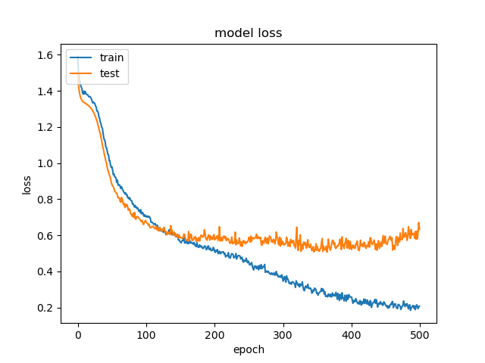
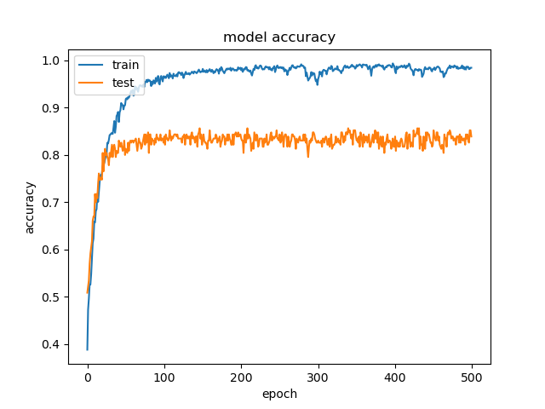
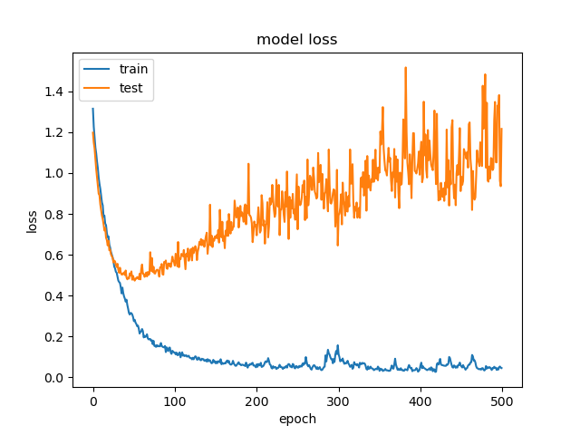
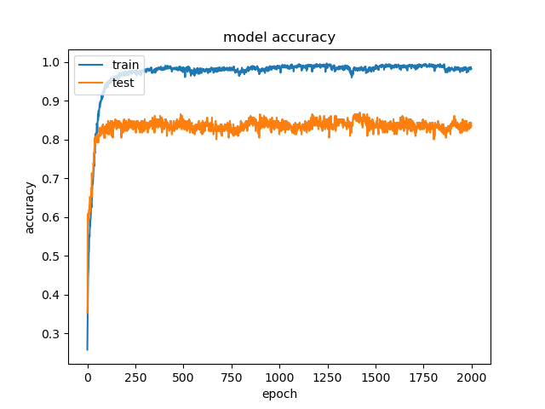
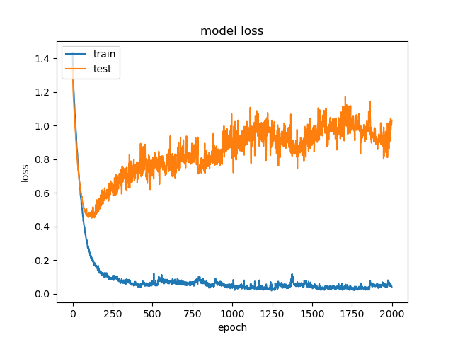
ANN
01
ANN
04
ANN
02
ANN
05
ANN
03
ANN
06

Slide 15
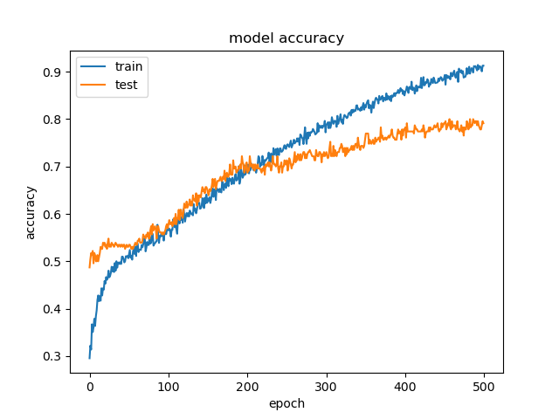
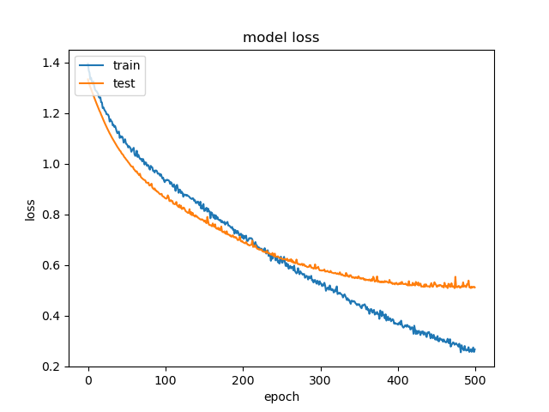
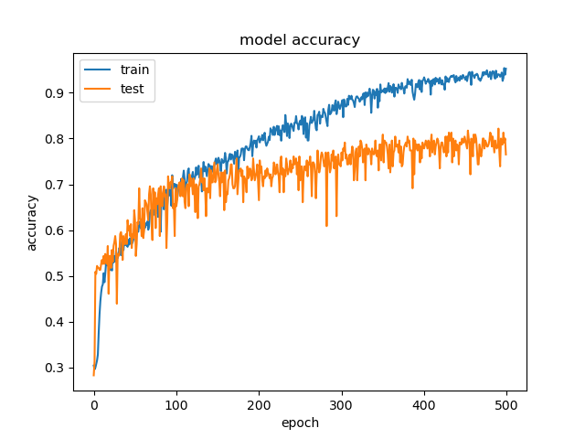
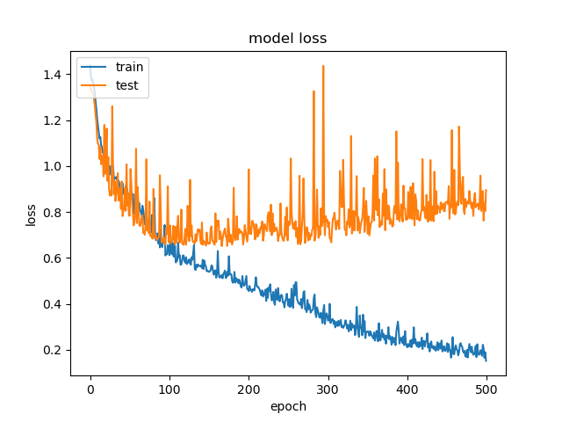
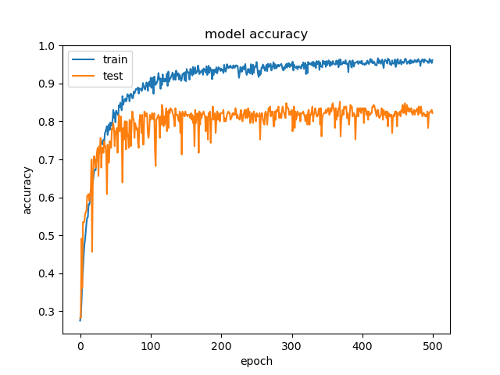
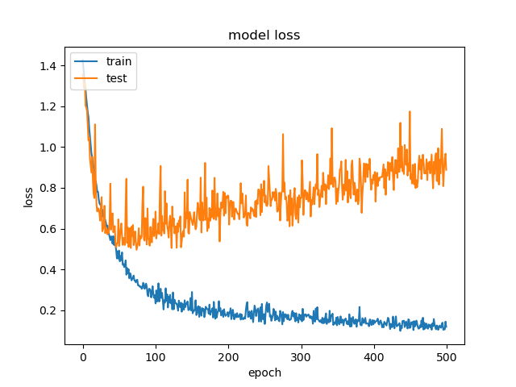
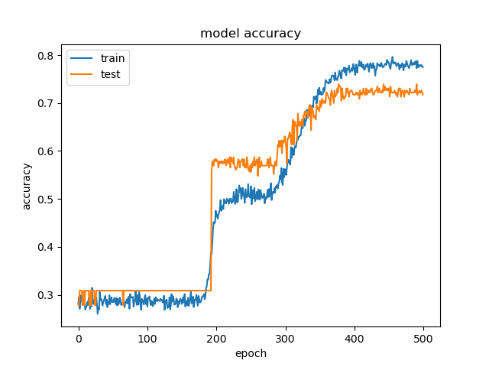
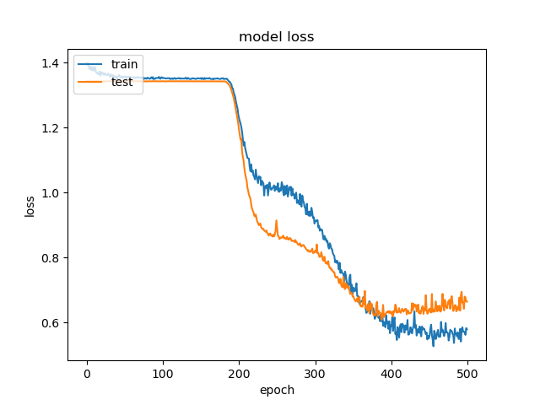
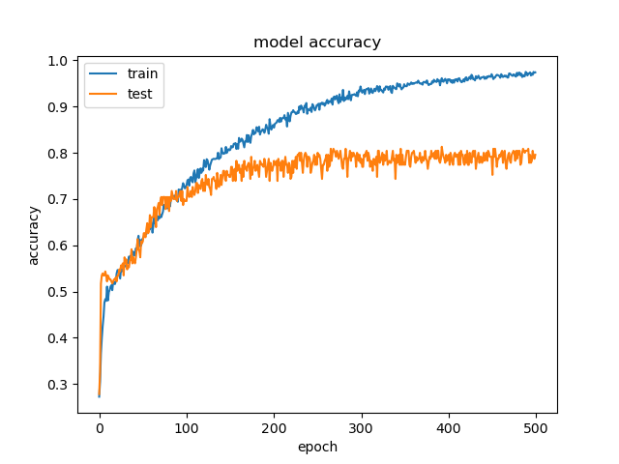
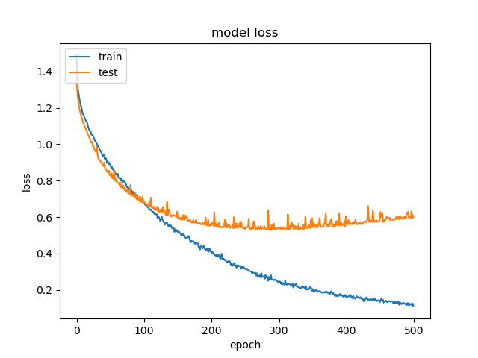
ANN
07
ANN
10
ANN
08
ANN
11
ANN
09

Slide 16
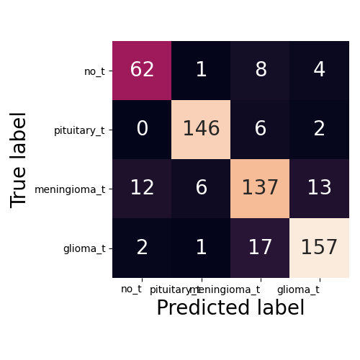
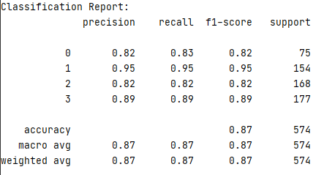
Modeling, Prediction and Evaluation - ANN
Hidden layers and Nodes: (500,500,20)/ Iteration: 500/ Activation: “sigmoid”/ Solver: RMSpro (lr=0.001)

Slide 17
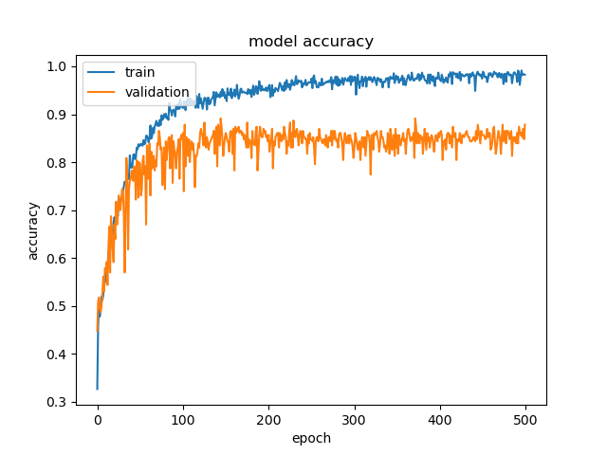
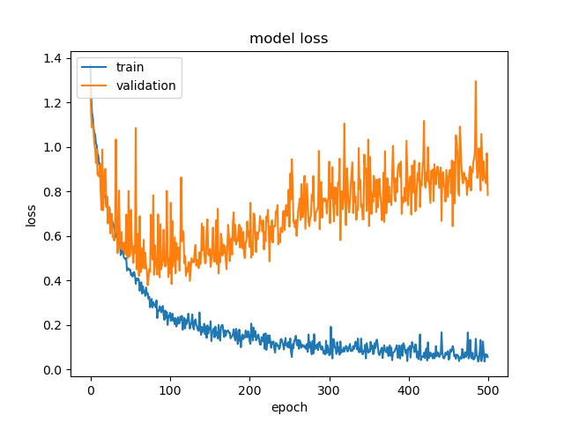
Modeling, Prediction and Evaluation - ANN

Slide 18
Summary and Discussion
1. Activation with “sigmoid” shows better performance and higher accuracy than activation with “relu” and “tanh”.
2. Solver with RMSprop shows higher prediction accuracy with the brain cancer dataset.
3. With ANN model, the accuracy for prediction can reach to 87%, which is better than other models including KNN, SVM and Naïve Bayes.
Deep learning with skills of convolution and maxpool need to be tried to get the accuracy higher……

Slide 19
References
1. Aldape, K., Brindle, K.M., Chesler, L. et al. Challenges to curing primary brain tumours. Nat Rev Clin Oncol 16, 509–520 (2019). https://doi.org/10.1038/s41571-019-0177-5
2. Cao, H., Erson-Omay, E.Z., Li, X. et al. A quantitative model based on clinically relevant MRI features differentiates lower grade gliomas and glioblastoma. Eur Radiol 30, 3073–3082 (2020). https://doi.org/10.1007/s00330-019-06632-8
3. Nadeem, M. W., Ghamdi, M., Hussain, M., Khan, M. A., Khan, K. M., Almotiri, S. H., & Butt, S. A. (2020). Brain Tumor Analysis Empowered with Deep Learning: A Review, Taxonomy, and Future Challenges. Brain sciences, 10(2), 118. https://doi.org/10.3390/brainsci10020118
4. Hollon, T.C., Pandian, B., Adapa, A.R. et al. Near real-time intraoperative brain tumor diagnosis using stimulated Raman histology and deep neural networks. Nat Med 26, 52–58 (2020). https://doi.org/10.1038/s41591-019-0715-9
5. Kingma, D.P., & Ba, J. (2015). Adam: A Method for Stochastic Optimization. CoRR, abs/1412.6980.
6. https://ml-cheatsheet.readthedocs.io/en/latest/index.html
7. https://ruder.io/optimizing-gradient-descent/index.html#adamax
8. https://miamineurosciencecenter.com/en/conditions/brain-tumors/types/
9. https://mlfromscratch.com/optimizers-explained/#/
10.

Slide 20
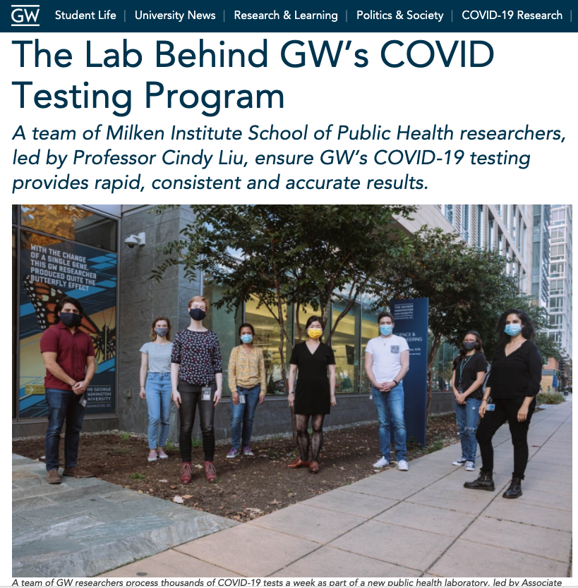
Shameless Plug
Help us save the world (by improving public health)

Slide 21
Thank You

Slide 22
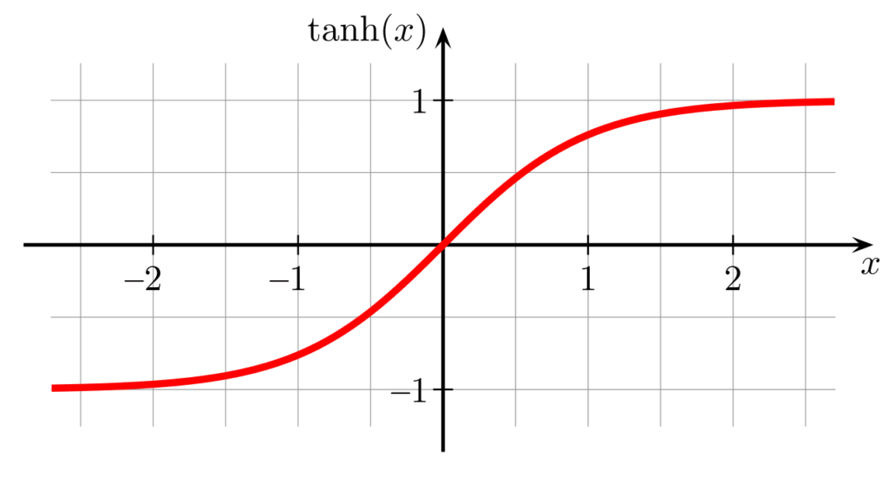
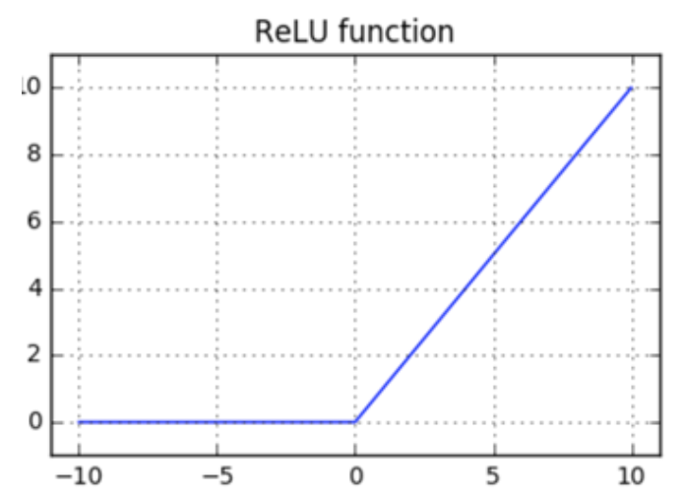
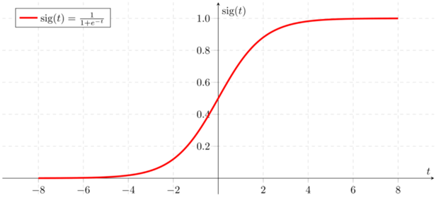
sigmoid
tanh
relu
y = 1/(1+e^{(-x)} )
y=tanh(x)
{ xi if x >=0
0 if x <=0 }
https://www.aitude.com/comparison-of-sigmoid-tanh-and-relu-activation-functions/
Sigmoid: not blowing up activation
Relu : not vanishing gradient

Slide 23
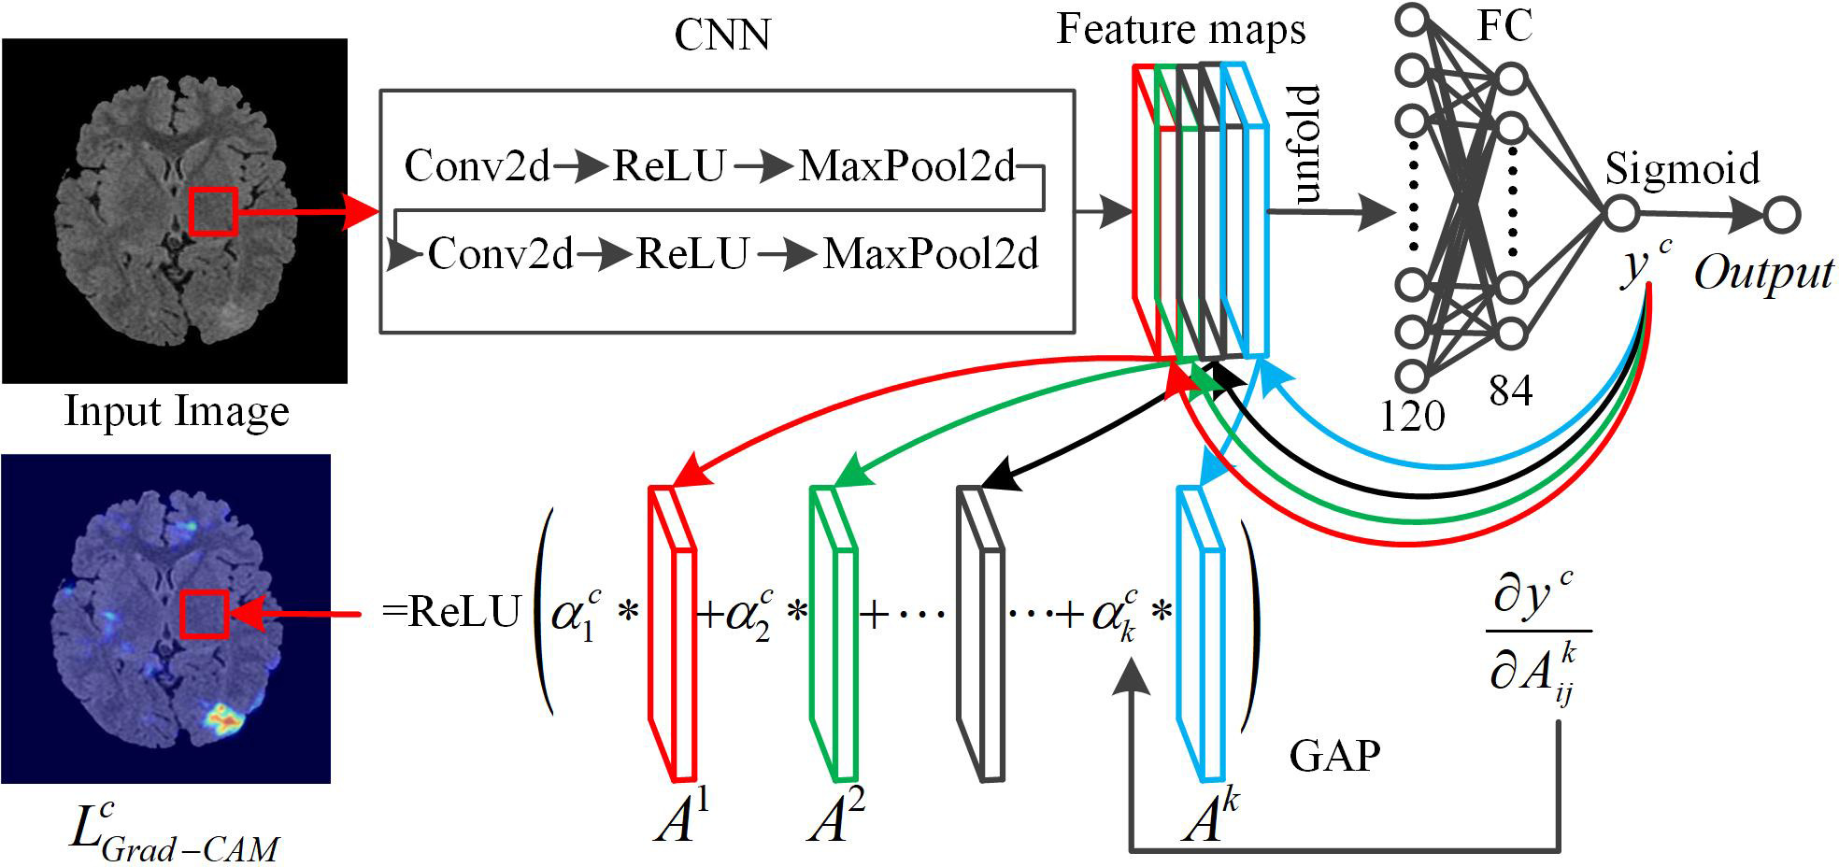
Modeling, Prediction and Evaluation - CNN

Slide 24
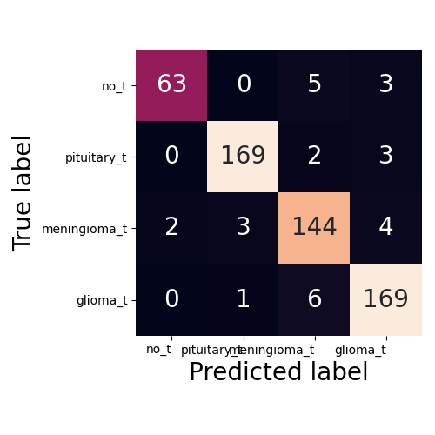
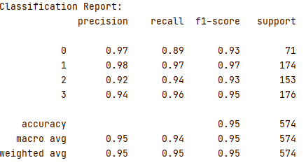
Modeling, Prediction and Evaluation - CNN

Slide 25
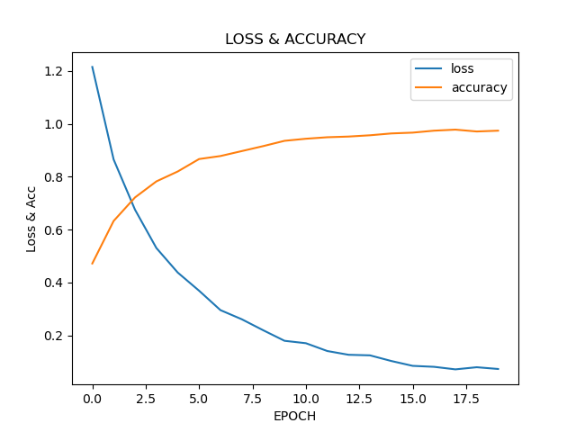
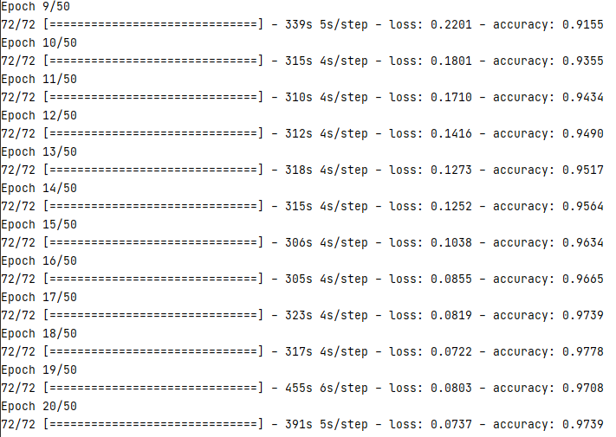
Modeling, Prediction and Evaluation - CNN

